Slide 1

Digital Electronics (303105220)
Alpita makwana, Assistant Professor
Mechatronics Engineering

Slide 2
CHAPTER-4
Sequential Circuits
A 1-bit memory, the circuit properties of Bi-stable latch, the clocked SR flip flop, J- K-T and D types flip flops, applications of flip flops, shift registers, applications of shift registers, ring counter, sequence generator, ripple (Asynchronous) counters, synchronous counters, special counter IC’s, asynchronous sequential counters, applications of counters.

Slide 3
Sequential Circuits
Sequential circuits are digital circuits that store and use the previous state information to determine their next state.
Unlike combinational circuits, which only depend on the current input values to produce outputs, sequential circuits depend on both the current inputs and the previous state stored in memory elements.
Sequential circuits are commonly used in digital systems to implement state machines, timers, counters, and memory elements.
The memory elements in sequential circuits can be implemented using flip-flops, which are circuits that store binary values and maintain their state even when the inputs change.

Slide 4
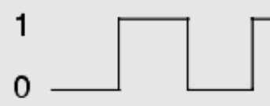


Sequential Circuits
Flip-flop: Another name for bistable multivibrator. Used for storing a single bit (memory element)
State of FF: State of Q
FF
$$Q$$
Normal output
State of FF:
High/1/SET , for Q=1
Low/0/RESET, for Q=0
Inputs
$$\overline{Q}$$
Inverted output
The inputs cause change in output state (Flip-Flop)
FF input is applied temporarily to change its output state.
Input applied in form of pulses.
The output now remains in new state, even when input is removed (Memory)
Used to store 1-bit of data.
Basic component of shift-registers and counters.
*Non-clocked FF is called Latch
Latch: Level-triggered
FF: Edge-triggered

Slide 5
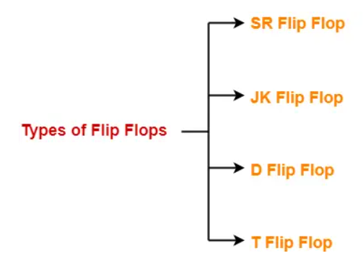
Sequential Circuits
A Flip Flop is a memory element that is capable of storing one bit of information.
It is also called as a Bistable Multivibrator since it has two stable states either 0 or 1.

Slide 6
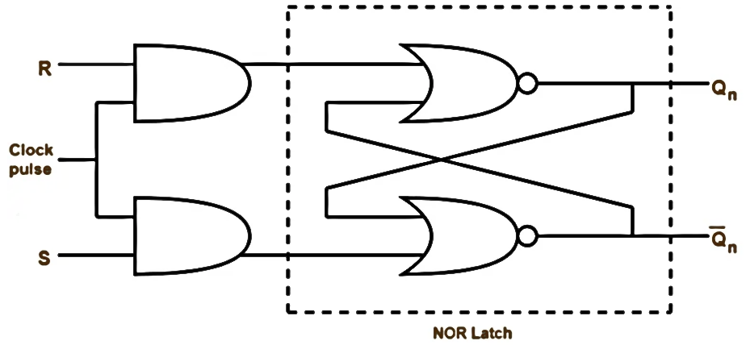
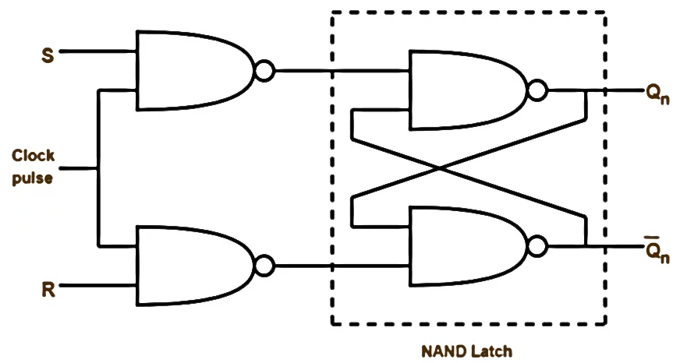
Sequential Circuits
Using NOR gates
Using NAND gates

Slide 7
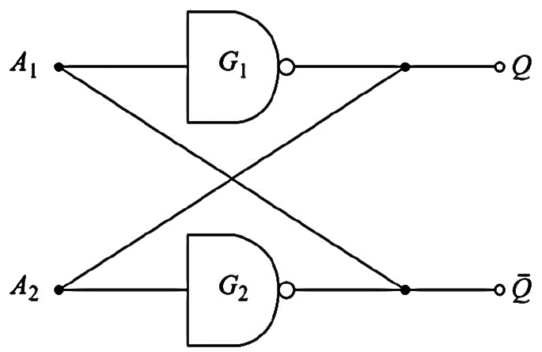










Sequential Circuits
Bistable Latch/RS Flip-flop: Circuit properties
Case I: $Q=1,\overline{Q}=0$
Case II: $Q=0,\overline{Q}=1$
$$\overline{Q}=0$$
$$Q=1$$
$$\overline{Q}=1$$
$$Q=0$$
$$Q=1$$
$$\overline{Q}=0$$
$$Q=0$$
$$\overline{Q}=1$$
NAND-GATES

Slide 8
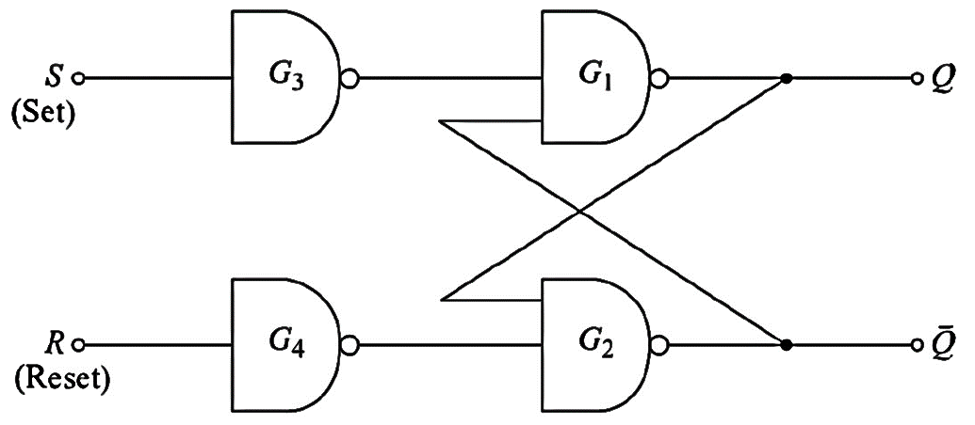
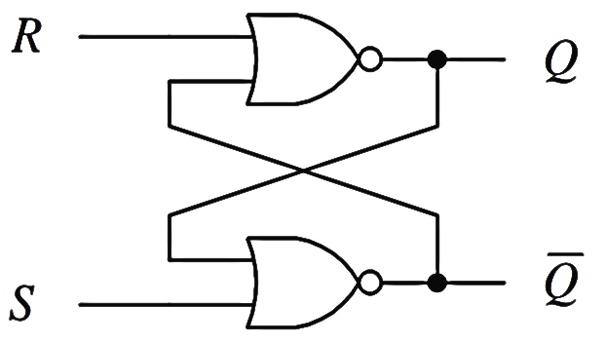
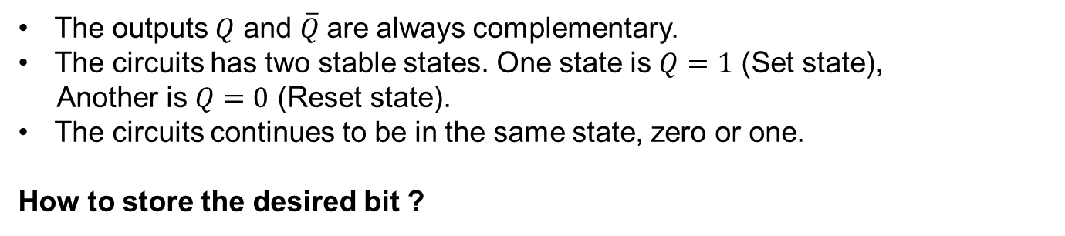
Sequential Circuits
Bistable Latch/RS Flip-flop: Circuit Properties
The outputs $Q$ and $\overline{Q}$are always complementary.
The circuits has two stable states. One state is $Q=1$ (Set state),
Another is $Q=0$ (Reset state).
The circuits continues to be in the same state, zero or one.
How to store the desired bit ?
Used to enter desired bit
NOR-GATES

Slide 9
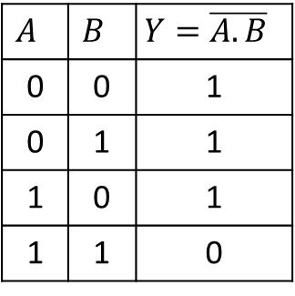
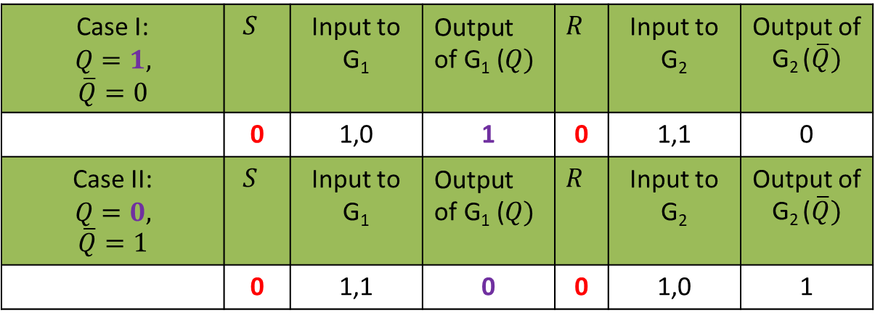
Sequential Circuits
$$A$$ | $$B$$ | $$Y=\overline{A.B}$$
0 | 0 | 1
0 | 1 | 1
1 | 0 | 1
1 | 1 | 0
Case I: $$Q=1, \overline{Q}=0$$ | $$S$$ | Input to G₁ | $$\text{Output} \text{of} \text{G}\text{1} \text{(}Q)$$ | $$R$$ | Input to G₂ | Output of G₂ ($\overline{Q})$
 | 0 | 1,0 | 1 | 0 | 1,1 | 0
Case II: $$Q=0, \overline{Q}=1$$ | $$S$$ | Input to G₁ | $$\text{Output} \text{of} \text{G}\text{1}\text{ (}Q)$$ | $$R$$ | Input to G₂ | Output of G₂ ($\overline{Q})$
 | 0 | 1,1 | 0 | 0 | 1,0 | 1

Slide 10
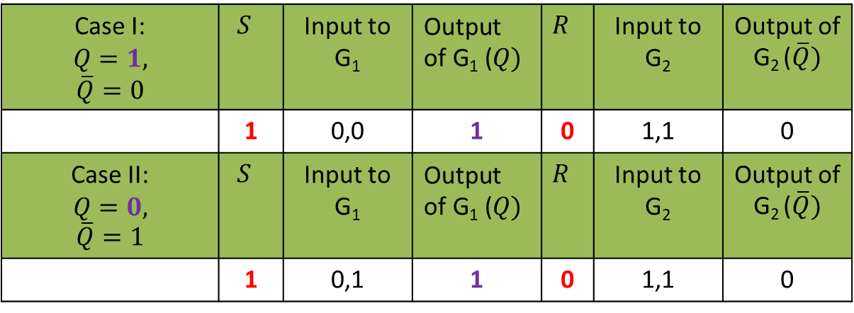
Sequential Circuits
$$A$$ | $$B$$ | $$Y=\overline{A.B}$$
0 | 0 | 1
0 | 1 | 1
1 | 0 | 1
1 | 1 | 0
Case I: $$Q=1, \overline{Q}=0$$ | $$S$$ | Input to G₁ | $$\text{Output} \text{of} \text{G}\text{1} \text{(}Q)$$ | $$R$$ | Input to G₂ | Output of G₂ ($\overline{Q})$
 | 1 | 0,0 | 1 | 0 | 1,1 | 0
Case II: $$Q=0, \overline{Q}=1$$ | $$S$$ | Input to G₁ | $$\text{Output} \text{of} \text{G}\text{1}\text{ (}Q)$$ | $$R$$ | Input to G₂ | Output of G₂ ($\overline{Q})$
 | 1 | 0,1 | 1 | 0 | 1,1 | 0

Slide 11
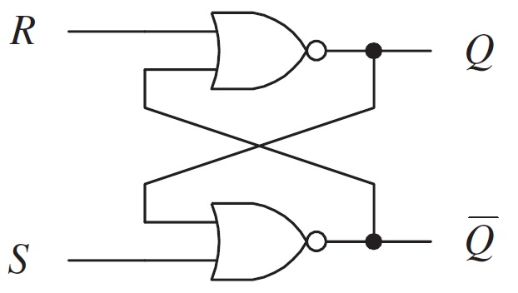

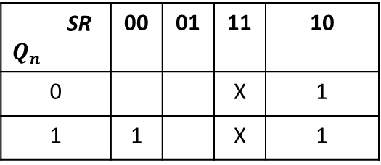


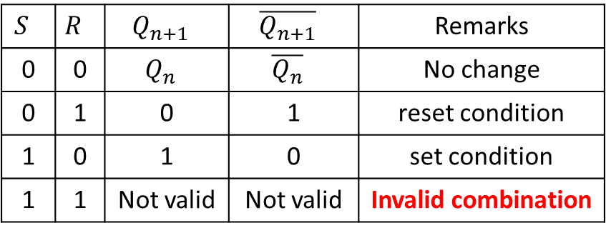


Sequential Circuits
SR $Q_{n}$ | 00 | 01 | 11 | 10
0 |  |  | X | 1
1 | 1 |  | X | 1
$$S$$ | $$R$$ | $$Q_{n+1}$$ | $$\overline{Q_{n+1}}$$ | Remarks
0 | 0 | $$Q_{n}$$ | $$\overline{Q_{n}}$$ | No change
0 | 1 | 0 | 1 | reset condition
1 | 0 | 1 | 0 | set condition
1 | 1 | Not valid | Not valid | Invalid combination
Characteristic eq. of SR-FF:
$$Q_{n+1}=S+Q_{n}\overline{R}$$
NAND
$$R$$
NOR
$$Q$$
$$S$$
$$Q$$

Slide 12
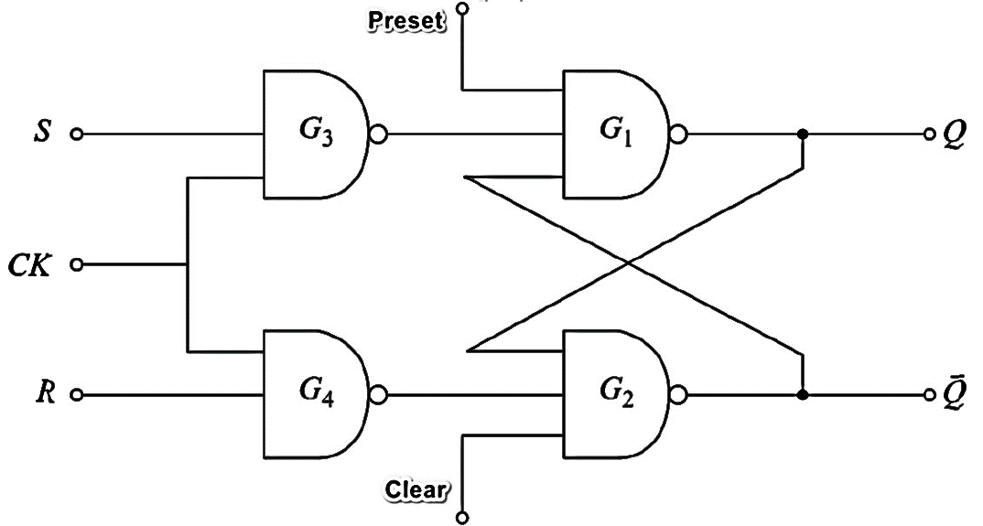
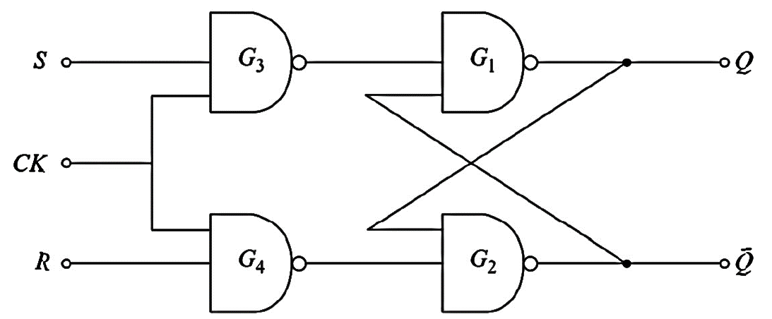
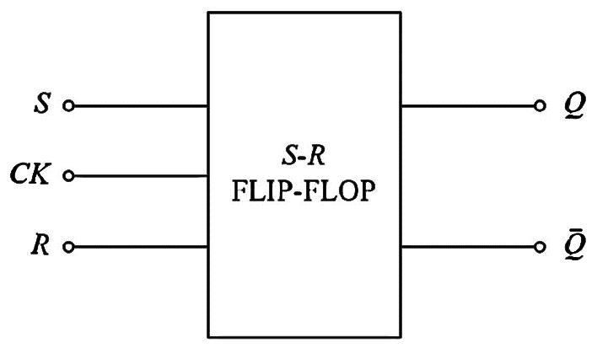
Sequential Circuits
Clocked RS flip flop
Inputs |  |  | Output Q | Operation
Clock (CK) | Clear (Cr) | Preset (Pr) | Q
1 | 1 | 1 | Q_{n+1} | Normal FF
0 | 0 | 1 | 0 | Clear
0 | 1 | 0 | 1 | Preset

Slide 13
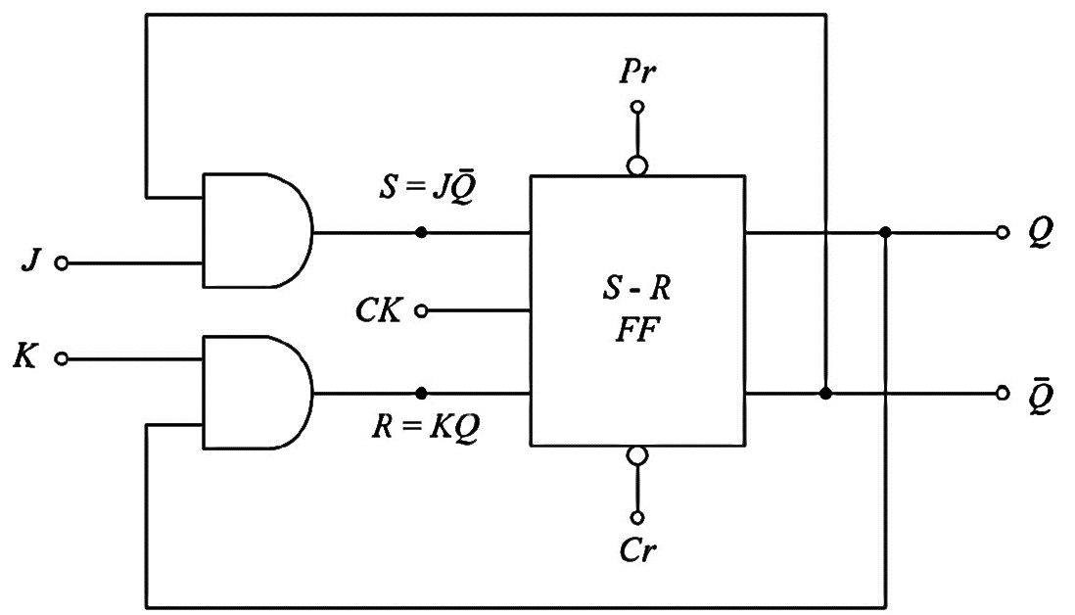
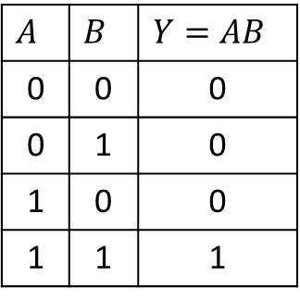
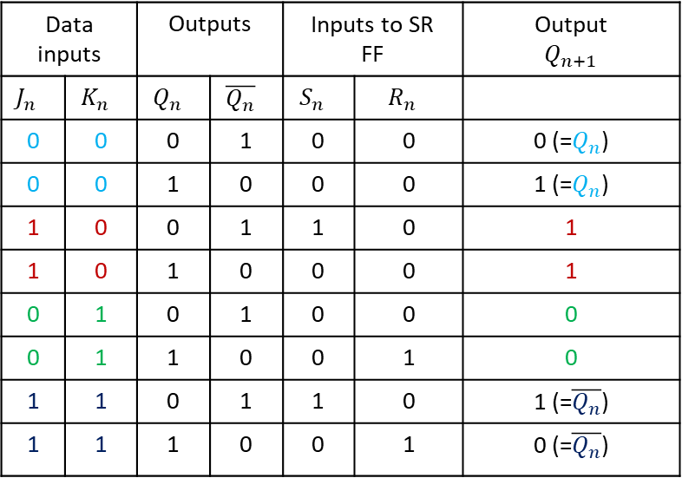
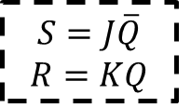
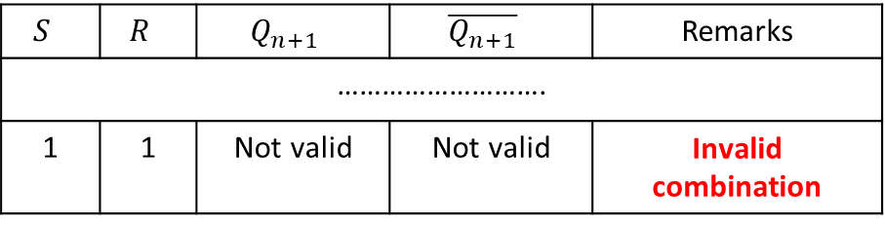
Sequential Circuits
JK- flip flop
$$S$$ | $$R$$ | $$Q_{n+1}$$ | $$\overline{Q_{n+1}}$$ | Remarks
……………………….
1 | 1 | Not valid | Not valid | Invalid combination
$$S=J\overline{Q}$$
$$R=KQ$$
$$A$$ | $$B$$ | $$Y=AB$$
0 | 0 | 0
0 | 1 | 0
1 | 0 | 0
1 | 1 | 1
Data inputs |  | Outputs |  | Inputs to SR FF |  | Output $$Q_{n+1}$$
$$J_{n}$$ | $$K_{n}$$ | $$Q_{n}$$ | $$\overline{Q_{n}}$$ | $$S_{n}$$ | $$R_{n}$$
0 | 0 | 0 | 1 | 0 | 0 | 0 (=$Q_{n}$)
0 | 0 | 1 | 0 | 0 | 0 | 1 (=$Q_{n}$)
1 | 0 | 0 | 1 | 1 | 0 | 1
1 | 0 | 1 | 0 | 0 | 0 | 1
0 | 1 | 0 | 1 | 0 | 0 | 0
0 | 1 | 1 | 0 | 0 | 1 | 0
1 | 1 | 0 | 1 | 1 | 0 | 1 (=$\overline{Q_{n}}$)
1 | 1 | 1 | 0 | 0 | 1 | 0 (=$\overline{Q_{n}}$)

Slide 14
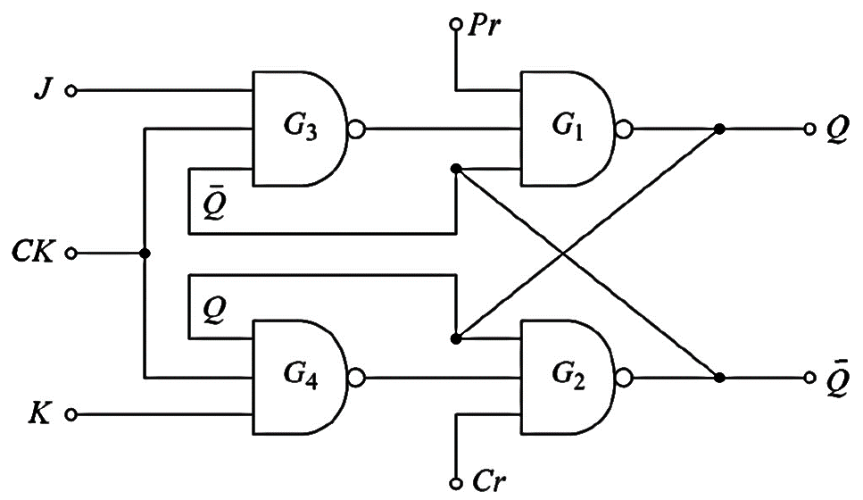

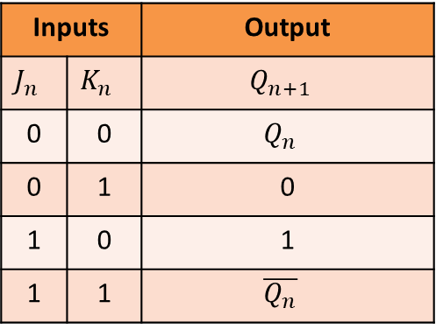
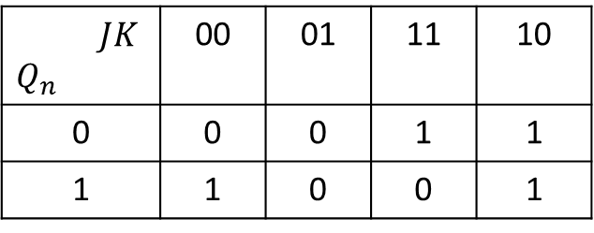
Sequential Circuits
Inputs |  | Output
$$J_{n}$$ | $$K_{n}$$ | $$Q_{n+1}$$
0 | 0 | $$Q_{n}$$
0 | 1 | 0
1 | 0 | 1
1 | 1 | $$\overline{Q_{n}}$$
JK- flip flop
$$JK$$ $$Q_{n}$$ | 00 | 01 | 11 | 10
0 | 0 | 0 | 1 | 1
1 | 1 | 0 | 0 | 1
$$Q_{n+1}=\overline{Q_{n}}J+Q_{n}\overline{K}$$

Slide 15


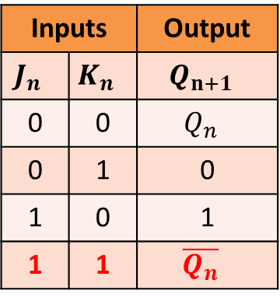



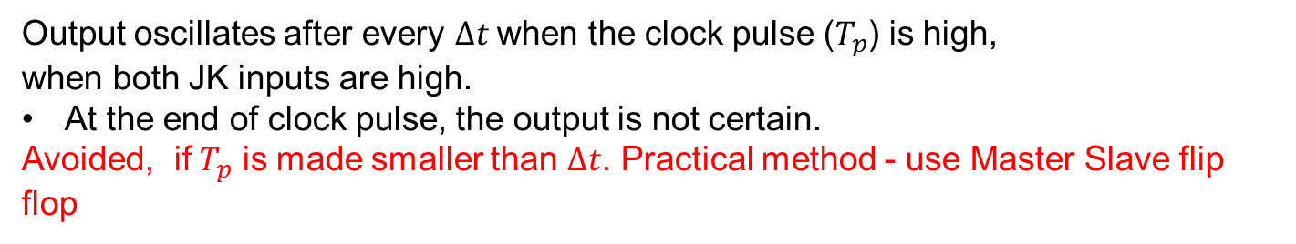
Sequential Circuits
Race-around condition
Inputs |  | Output
$$J_{n}$$ | $$K_{n}$$ | $$Q_{n+1}$$
0 | 0 | $$Q_{n}$$
0 | 1 | 0
1 | 0 | 1
1 | 1 | $$\overline{Q_{n}}$$
$$∆t$$
$$T_{p}$$
$$0$$
$$T$$
Trailing (negative) edge
Leading (positive) edge
$∆t:$The propagation delay through two NAND gates in series.
Output oscillates after every $∆t$when the clock pulse ($T_{p}$) is high,
when both JK inputs are high.
At the end of clock pulse, the output is not certain.
Avoided, if $T_{p}$ is made smaller than $∆t$. Practical method - use Master Slave flip flop

Slide 16
Sequential Circuits
Master-Slave Flip-flop (Pulse triggered FF)
The Race-around Condition can be avoided by ensuring that the clock input is at logic “1” only for a very short time.
The Master-Slave Flip-Flop is a combination of two JK flip-flops connected in a series configuration.
One acts as the “master” and the other as a “slave”.
The output from the master flip-flop is connected to the two inputs of the slave flip flop whose output is fed back to the inputs of the master flip-flop.
In addition to these two flip-flops, the circuit also includes an inverter.
The inverter is connected to the clock pulse in such a way that the inverted clock pulse is given to the slave flip-flop. In other words if CLK=0 for a master flip-flop, then CLK=1 for a slave flip-flop, and if CLK=1 for a master flip flop then it becomes 0 for a slave flip-flop.

Slide 17
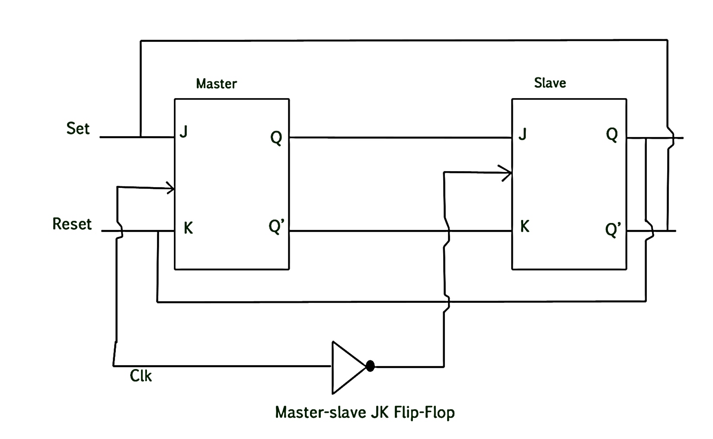
Sequential Circuits
Master-Slave Flip-flop (Pulse triggered FF)

Slide 18
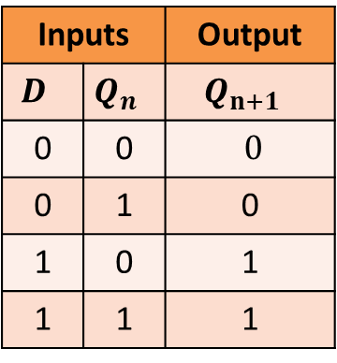
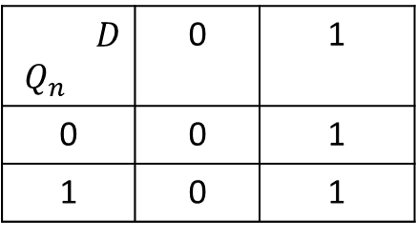

Sequential Circuits
D (Delay) flip flop
Inputs |  | Output
$$D$$ | $$Q_{n}$$ | $$Q_{n+1}$$
0 | 0 | $$0$$
0 | 1 | 0
1 | 0 | 1
1 | 1 | 1
$${Characteristic Eq.: Q}_{n+1}=D$$
$$D$$ $$Q_{n}$$ | 0 | 1
0 | 0 | 1
1 | 0 | 1
Characteristic Table of D-FF

Slide 19
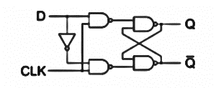
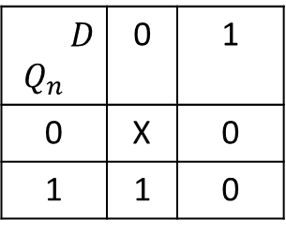

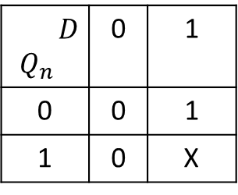
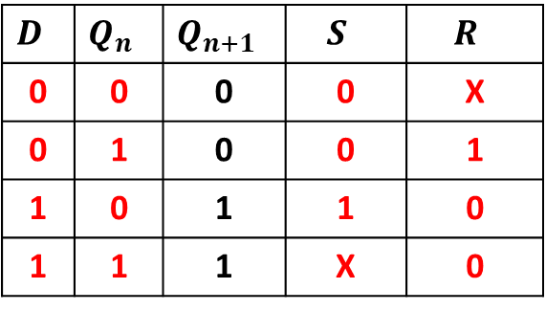

Sequential Circuits
D flip flop: From SR flip flop
S
$$D$$ | $$Q_{n}$$ | $$Q_{n+1}$$ | $$S$$ | $$R$$
0 | 0 | 0 | 0 | X
0 | 1 | 0 | 0 | 1
1 | 0 | 1 | 1 | 0
1 | 1 | 1 | X | 0
R
$$D$$ $$Q_{n}$$ | 0 | 1
0 | 0 | 1
1 | 0 | X
$$D$$ $$Q_{n}$$ | 0 | 1
0 | X | 0
1 | 1 | 0
Characteristic Table
of D-FF
Excitation table
of SR-FF
$$S=D$$
$$R=\overline{D}$$

Slide 20
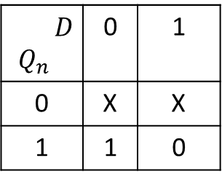

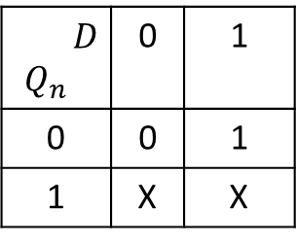


Sequential Circuits
D flip flop: From JK flip flop
J
$$D$$ | $$Q_{n}$$ | $$Q_{n+1}$$ | $$J$$ | $$K$$
0 | 0 | 0 | 0 | X
0 | 1 | 0 | X | 1
1 | 0 | 1 | 1 | X
1 | 1 | 1 | X | 0
K
$$D$$ $$Q_{n}$$ | 0 | 1
0 | 0 | 1
1 | X | X
$$D$$ $$Q_{n}$$ | 0 | 1
0 | X | X
1 | 1 | 0
Characteristic Table
of D-FF
Excitation table
of JK-FF
$$J=D$$
$$K=\overline{D}$$

Slide 21
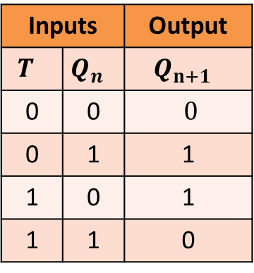
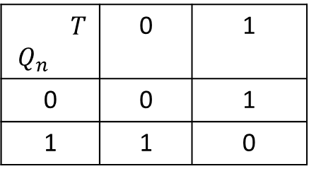
Sequential Circuits
T (Toggle) flip flop
Inputs |  | Output
$$T$$ | $$Q_{n}$$ | $$Q_{n+1}$$
0 | 0 | $$0$$
0 | 1 | 1
1 | 0 | 1
1 | 1 | 0
$${Characteristic Eq.: Q}_{n+1}=T\overline{Q_{n}}+\overline{T}Q_{n}=T⊕Q_{n}$$
$$T$$ $$Q_{n}$$ | 0 | 1
0 | 0 | 1
1 | 1 | 0
Characteristic Table of T-FF

Slide 22
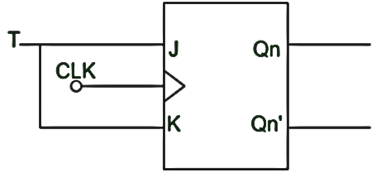
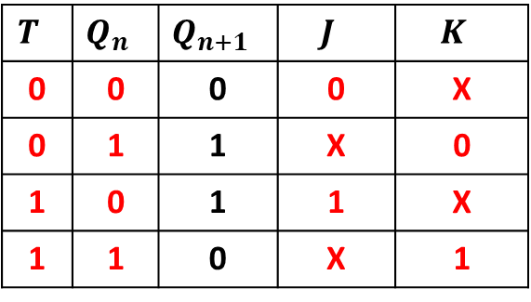

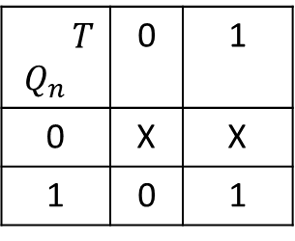

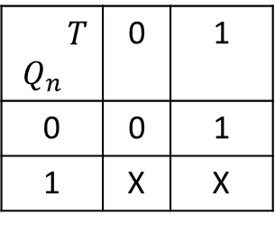
Sequential Circuits
T flip flop: From JK flip flop
$$T$$ | $$Q_{n}$$ | $$Q_{n+1}$$ | $$J$$ | $$K$$
0 | 0 | 0 | 0 | X
0 | 1 | 1 | X | 0
1 | 0 | 1 | 1 | X
1 | 1 | 0 | X | 1
$$T$$ $$Q_{n}$$ | 0 | 1
0 | 0 | 1
1 | X | X
$$T$$ $$Q_{n}$$ | 0 | 1
0 | X | X
1 | 0 | 1
Characteristic Table
of T-FF
Excitation table
of JK-FF
$$J=T$$
$$K=T$$

Slide 23
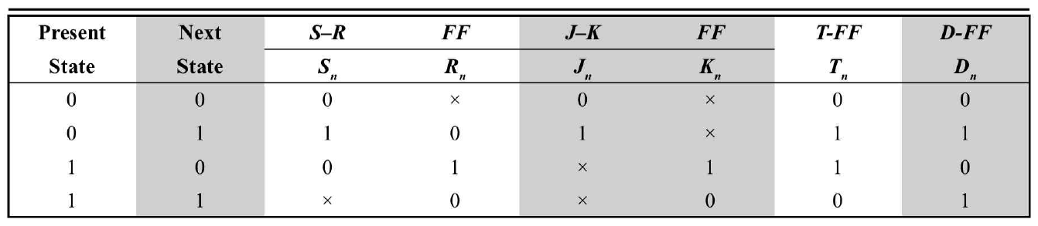
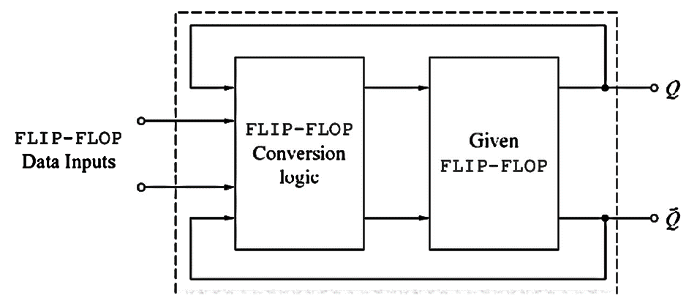
Sequential Circuits
Excitation Tables of FFs:
Flip-flop conversion

Slide 24
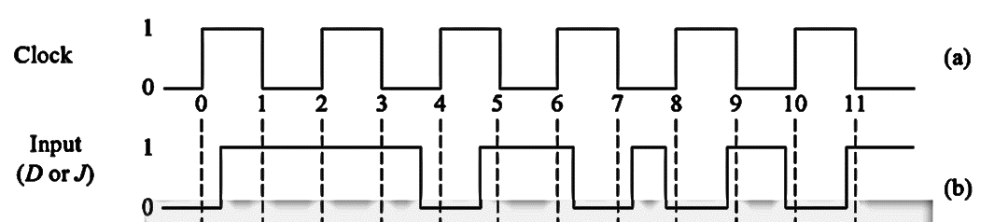
Sequential Circuits
Timing diagrams of FFs:
Q: Consider the following Clock and Input waveforms to the FF.
Sketch the output waveforms for the following FFs:
Positive-edge triggered D-type FF 74 AHC74.
Positive-level triggered D-type FF 7475.
Negative-edge triggered JK-Flip flop 74HC112.

Slide 25
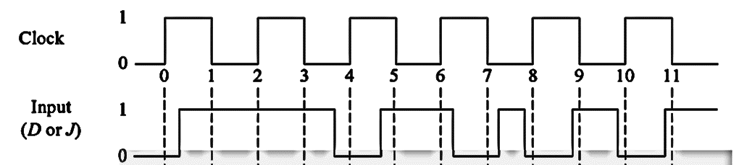
Sequential Circuits
Positive-edge
Positive-level
Negative-edge

Slide 26
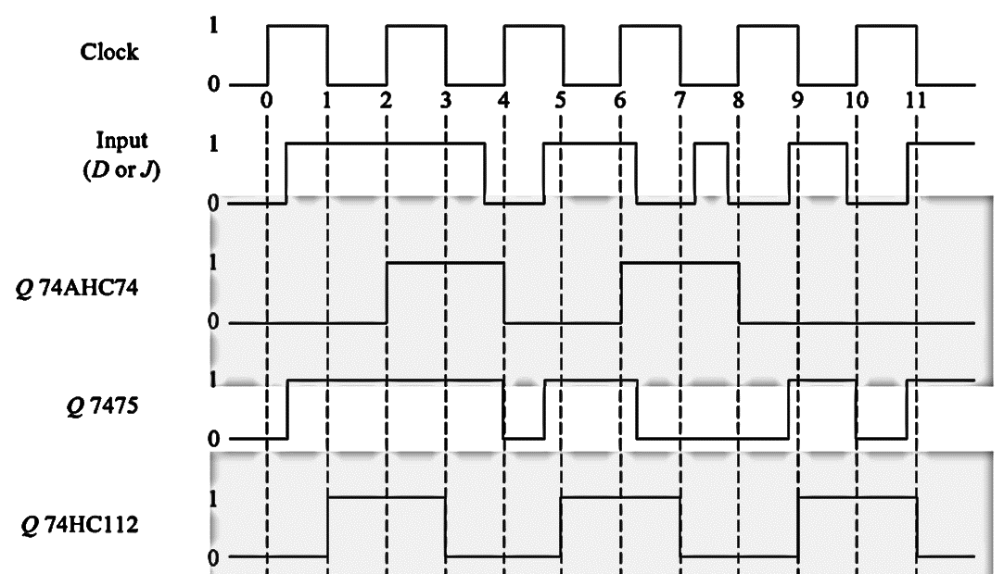
Sequential Circuits
(Positive-edge
Triggered)
(Positive-level
Triggered)
(Negative-edge
triggered)

Slide 27
Sequential Circuits
Applications of flip flop:
Frequency dividers
Counters
Storage registers
Shift registers
Data storage
Bounce elimination switch
Latch
Data transfer
Memory
Registers

Slide 28
Sequential Circuits
Shift Registers:
A Register is a device that is used to store such information.
Intel's 8085 processor contains many 8-bit registers for storage and result purposes,
It is a group of flip-flops connected in series used to store multiple bits of data. The information stored within these registers can be transferred with the help of shift registers.
Shift Register is a group of flip flops used to store multiple bits of data. The bits stored in such registers can be made to move within the registers and in/out of the registers by applying clock pulses.
An n-bit shift register can be formed by connecting n flip-flops, where each flip-flop stores a single bit of data.
The registers which will shift the bits to the left are called Shift-left registers. The registers which will shift the bits to the right are called Shift-right registers

Slide 29
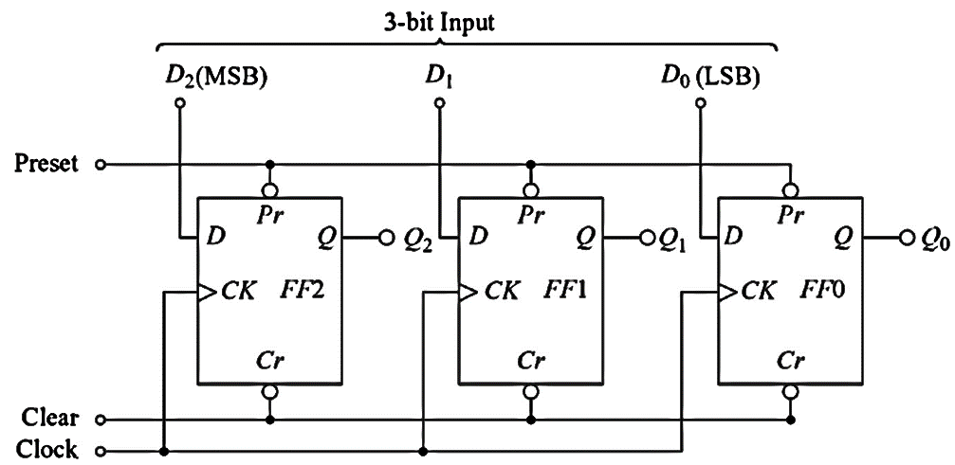
Sequential Circuits
Data can be entered and retrieved in following forms:
Serial-In Serial-out
Serial-in Parallel-out
Parallel-in serial-out
Parallel-in parallel-out
A 3-bit shift-register using 7474 positive-edge triggered FF

Slide 30
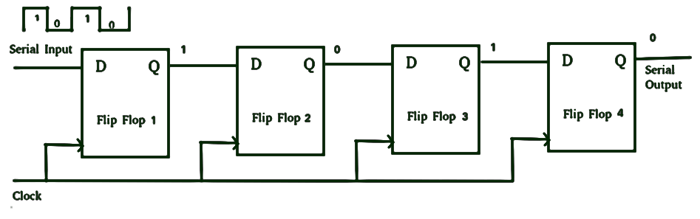
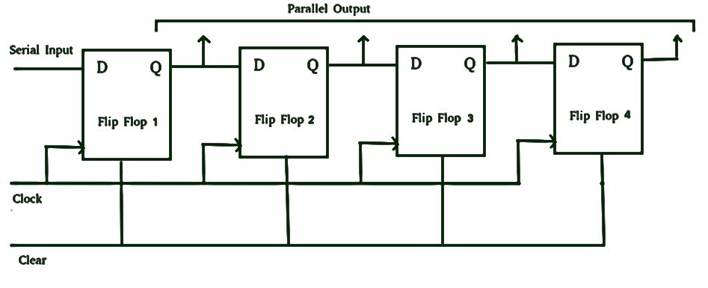


Sequential Circuits

Slide 31

Sequential Circuits
Shift Register Application - Ring Counter:
Typical application of the Shift register.
The output of the last flip-flop is connected to the input of the first flip-flop in the case of the ring counter but in the case of the shift register it is taken as output.
Except for this, all the other things are the same.
Clock (-ve
Edge-Triggered)
Overriding Input

Slide 32

Sequential Circuits
The clock pulse (CLK) is simultaneously applied to all the flip-flops. (Synchronous Counter)
Also, here we use Overriding input (ORI) for each flip-flop - Preset (PR) and Clear (CLR) are used as ORI.
When PR is 0, then the output is 1, and when CLR is 0, then the output is 0.
PR and CLR are active low signals that always work in value 0.
PR = 0, Q = 1; CLR= 0, Q = 0

Slide 33
Sequential Circuits
ORI is connected to Preset (PR) in FF-0 and it is connected to Clear (CLR) in FF-1, FF-2, and FF-3.
Output Q = 1 is generated at FF-0, and the rest of the flip-flop generates output Q = 0.
This output Q = 1 at FF-0 is known as Preset 1, which is used to form the ring in the Ring Counter.
Preset 1
ORI | CLK | Q0 | Q1 | Q2 | Q3
0 | X | 1 | 0 | 0 | 0
1 | 0 | 0 | 1 | 0 | 0
1 | 0 | 0 | 0 | 1 | 0
1 | 0 | 0 | 0 | 0 | 1
1 | 0 | 1 | 0 | 0 | 0
Counter states (modulo-n)

Slide 34

Sequential Circuits
ORI | CLK | Q0 | Q1 | Q2 | Q3
0 | X | 1 | 0 | 0 | 0
1 | 0 | 1 | 1 | 0 | 0
1 | 0 | 1 | 1 | 1 | 0
1 | 0 | 1 | 1 | 1 | 1
1 | 0 | 0 | 1 | 1 | 1
1 | 0 | 0 | 0 | 1 | 1
1 | 0 | 0 | 0 | 0 | 1
1 | 0 | 0 | 0 | 0 | 0
1 | 0 | 1 | 0 | 0 | 0
Johnson’s counter
Counts 2*n states (modulo-2n)
Counter states

Slide 35
Sequential Circuits
STRAIGHT RING COUNTER | TWISTED RING COUNTER
It connects the output of the last shift register to the input of first shift register. | It connects the complement of output of the last shift register to the input of the first register.
It is known as One hot counter. | It is known as Walking ring counter or Johnson’s counter.
Number of states = number of flip-flops | Number of states = 2 x number of flip-flops
It circulates a single bit (0 or 1) around the ring. | It circulates stream of 1 followed by stream of 0.
PRESET is used in first shift register. | PRESET is not used in twisted ring counter.
CLEAR is used for last (n-1) flip-flops. | CLEAR is used for all flip-flips in it.
It is used in successive approximation and stepper motor control. | It is used in phase shift or function generator.

Slide 36



Sequential Circuits
Shift registers are also utilized in Sequence generator circuits
Sequence generator: generates a given sequence of bits (in synchronism with a clock)
$$Y=f(Q_{N−1},Q_{N−2},…, Q_{1},Q_{0})$$
The minimum no. of FFs (N) required to generate a sequence of length S-
$S≤2^{N}−1$

Slide 37



Sequential Circuits
Q: Generate a sequence …1101011…
The minimum no. of FFs (N) required to generate a sequence of length 7: $7≤2^{N}−1$. So, $N≥3.$
No. of clock pulses | Flip-flop outputs
 | $$Q_{2}$$ | $$Q_{1}$$ | $$Q_{0}$$
1 | 1 | 1 | 1
2 | 1 | 1 | 1
3 | 0 | 1 | 1
4 | 1 | 0 | 1
5 | 0 | 1 | 0
6 | 1 | 0 | 1
7 | 1 | 1 | 0
. | . | . | .
. | . | . | .
Same states
$$⟹N>3$$
$$⟹N=4$$

Slide 38


Sequential Circuits
$$N=4$$
Q: Generate a sequence …1101011…
No. of clock pulses | Flip-flop outputs |  |  |  | Serial input Y
 | $$Q_{3}$$ | $$Q_{2}$$ | $$Q_{1}$$ | $$Q_{0}$$ | Serial input Y
1 | 1 | 1 | 1 | 0 | 1
2 | 1 | 1 | 1 | 1 | 0
3 | 0 | 1 | 1 | 1 | 1
4 | 1 | 0 | 1 | 1 | 0
5 | 0 | 1 | 0 | 1 | 1
6 | 1 | 0 | 1 | 0 | 1
7 | 1 | 1 | 0 | 1 | 1
1 | 1 | 1 | 1 | 0 | 1
2 | 1 | 1 | 1 | 1 | 0
3 | 0 | 1 | 1 | 1 | 1
Diff. states

Slide 39





Sequential Circuits
Q: Generate a sequence …1101011…
$Q_{3}Q_{2}$ $Q_{1}Q_{0}$ | 00 | 01 | 11 | 10
00 | X | X | X | X
01 | X | 1 | 1 | X
11 | X | 1 | 0 | 0
10 | X | X | 1 | 1
$$\overline{Q_{3}}$$
$$\overline{Q_{1}}$$
$$\overline{Q_{0}}$$
$$Y=\overline{Q_{3}}+\overline{Q_{1}}+\overline{Q_{0}}$$

Slide 40





Sequential Circuits
Counters:
Asynchronous (ripple counter): All FFs not clocked simultaneously
Synchronous (Ring: modulo-n, Twisted ring: modulo-2n) counter: All FFs clocked simultaneously
However, total possible states with n-FFs: $2^{n}$
$⇒(modulo−2^{n}$) counter is possible
up-counter
Counter state | Count
 | $$Q_{2}$$ | $$Q_{1}$$ | $$Q_{0}$$
0 | 0 | 0 | 0
1 | 0 | 0 | 1
2 | 0 | 1 | 0
3 | 0 | 1 | 1
4 | 1 | 0 | 0
5 | 1 | 0 | 1
6 | 1 | 1 | 0
7 | 1 | 1 | 1
up-counter & down-counter
$Q_{0}$ changes from 0 to 1
$Q_{0}$ changes from 1 to 0, $Q_{1}$ changes from 0 to 1
$Q_{0}$ changes from 1 to 0, $Q_{1}$ changes from 1 to 0,
$Q_{2}$ changes from 0 to 1
$Q_{0}$ changes with every clock pulse
$Q_{1}$ changes with every 2-clock pulses
$Q_{2}$ changes with every 4-clock pulses

Slide 41

Sequential Circuits
Design Procedure:
Q₀ needs to change with every clock pulse.
So, the input to FF₀ is T₀=1, and the external clock is provided to FF₀.
Q₁ toggles when Q₀ goes from 1 to 0.
It means that the Negative edge of Q₀ toggles Q₁. So we can use Q₀ as the clock input for FF₁.
Q₂ toggles when Q₁ goes from 1 to 0 (negative edge).
This is used as a clock signal for FF₂.
A 3-bit binary counter

Slide 42

Sequential Circuits
0
1
0
1
0
1
0
1
0
0
1
1
0
1
0
0
0
1
0
0
0
0
1
1
1
1
0

Slide 43


Sequential Circuits
Q. Design a mod-5 synchronous up counter using J-K flip flop
$$Q_{c}$$ | $$Q_{b}$$ | $$Q_{a}$$
0 | 0 | 0
0 | 0 | 1
0 | 1 | 0
0 | 1 | 1
1 | 0 | 0
1 | 0 | 1
1 | 1 | 0
1 | 1 | 1
$$Q_{n}$$ | $$Q_{n+1}$$ | $$J$$ | $$K$$
0 | 0 | 0 | X
0 | 1 | 1 | X
1 | 0 | X | 1
1 | 1 | X | 0
Desired states
Excitation table of JK FF

Slide 44


Sequential Circuits
Q. Design a mod-5 synchronous up counter using J-K flip flop
$$Q_{c}$$ | $$Q_{b}$$ | $$Q_{a}$$
0 | 0 | 0
0 | 0 | 1
0 | 1 | 0
0 | 1 | 1
1 | 0 | 0
1 | 0 | 1
1 | 1 | 0
1 | 1 | 1
Present state |  |  | Next state |  |  | Flip flop inputs
$$Q_{c}$$ | $$Q_{b}$$ | $$Q_{a}$$ | $$Q_{c+1}$$ | $$Q_{b+1}$$ | $$Q_{a+1}$$ | $$J_{c}$$ | $$K_{c}$$ | $$J_{b}$$ | $$K_{b}$$ | $$J_{a}$$ | $$K_{a}$$
0 | 0 | 0 | 0 | 0 | 1 | 0 | X | 0 | X | 1 | X
0 | 0 | 1 | 0 | 1 | 0 | 0 | X | 1 | X | X | 1
0 | 1 | 0 | 0 | 1 | 1 | 0 | X | X | 0 | 1 | X
0 | 1 | 1 | 1 | 0 | 0 | 1 | X | X | 1 | X | 1
1 | 0 | 0 | 0 | 0 | 0 | X | 1 | 0 | X | 0 | X
1 | 0 | 1 | X | X | X | X | X | X | X | X | X
1 | 1 | 0 | X | X | X | X | X | X | X | X | X
1 | 1 | 1 | X | X | X | X | X | X | X | X | X
Desired states
Excitation table for mod-5 counter

Slide 45












Sequential Circuits
$$Q_{c}Q_{b}$$ $$Q_{a}$$ | 00 | 01 | 11 | 10
0 | 0 | 0 | x | x
1 | 0 | 1 | x | x
$$Q_{c}Q_{b}$$ $$Q_{a}$$ | 00 | 01 | 11 | 10
0 | x | x | x | 1
1 | x | x | x | x
$$J_{c}=Q_{a}Q_{b}$$
$$K_{c}=1$$
$$Q_{c}Q_{b}$$ $$Q_{a}$$ | 00 | 01 | 11 | 10
0 | 0 | x | x | 0
1 | 1 | x | x | x
$$Q_{c}Q_{b}$$ $$Q_{a}$$ | 00 | 01 | 11 | 10
0 | x | 0 | 1 | x
1 | x | x | x | x
$$J_{b}=Q_{a}$$
$$K_{b}=Q_{c}$$
$$Q_{c}Q_{b}$$ $$Q_{a}$$ | 00 | 01 | 11 | 10
0 | 1 | 1 | x | 0
1 | x | x | x | x
$$Q_{c}Q_{b}$$ $$Q_{a}$$ | 00 | 01 | 11 | 10
0 | x | x | x | x
1 | 1 | 1 | x | x
$$J_{a}=\overline{Q_{c}}$$
$$K_{a}=1$$

Slide 46


















Sequential Circuits
$$J_{c}=Q_{a}Q_{b}$$
$$K_{c}=1$$
$$J_{b}=Q_{a}$$
$$K_{b}=Q_{c}$$
$$J_{a}=\overline{Q_{c}}$$
$$K_{a}=1$$
$$J_{a}$$
$$Q_{a}$$
$$J_{b}$$
$$Q_{b}$$
$$J_{c}$$
$$Q_{c}$$
$$K_{a}$$
$$\overline{Q_{a}}$$
$$K_{b}$$
$$\overline{Q_{b}}$$
$$K_{c}$$
$$\overline{Q_{c}}$$
CLK
Logic “1”
mod-5 synchronous up-counter using J-K flip flop

Slide 47
Sequential Circuits
Special counter ICs:
74HC161
74HC163
74HC191
74HC160
CD4017B
Applications of counters:
Pulse counting
Frequency division
Digital clocks
Analog-to-digital converters

